Slide 1
M.H.M.
Novamen
Marko Henien, Helen Li,
Mercy Oladipo

Slide 2
THE PROBLEM
Current methods of opioid delivery render patients highly susceptible to opioid addiction, causing several issues to the patient and his/her family members.
Clinical Need
Opioid addiction is an epidemic especially in larger states such as Texas and California.
2.4 million Americans have an opioid use disorder
50,000 Americans die each day because of an opioid overdose
Target Population
For our solution, we are targeting the post-surgery patient population because they are often being administered large doses of opioids for pain relief, making them more vulnerable to addiction.

Slide 3
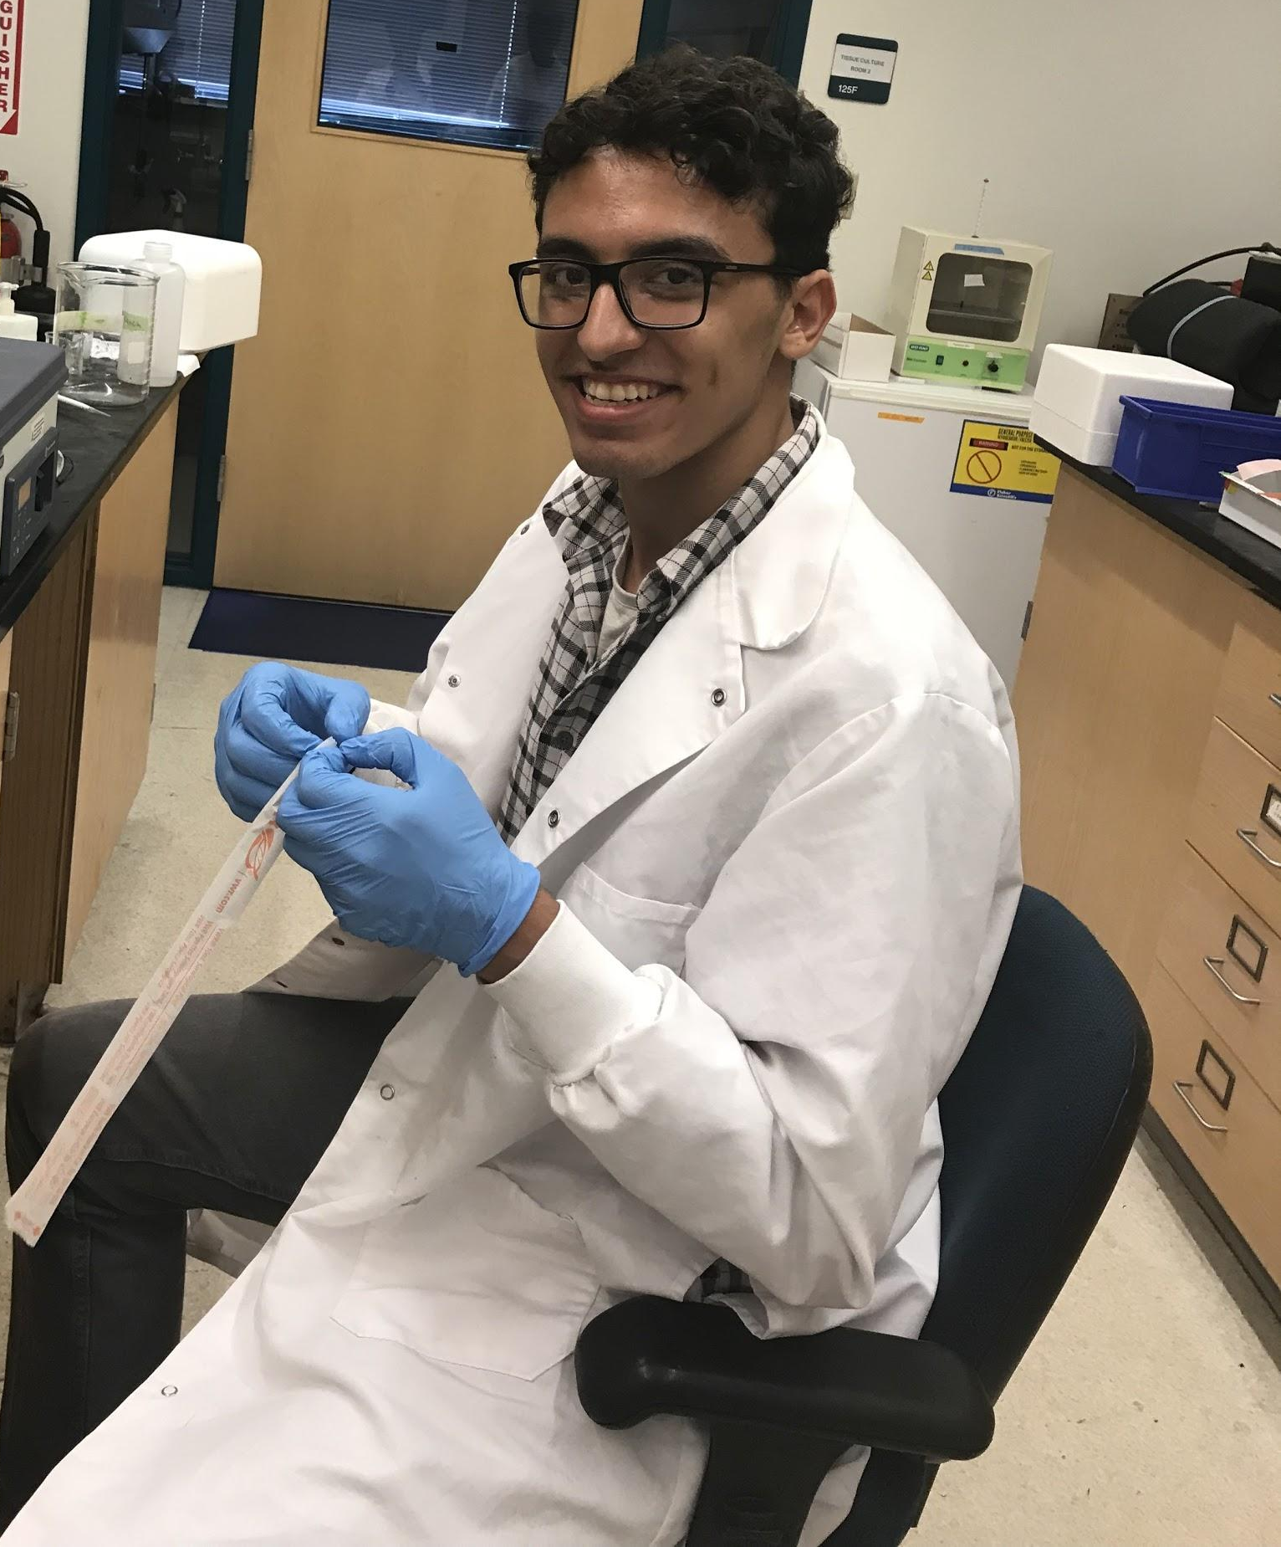
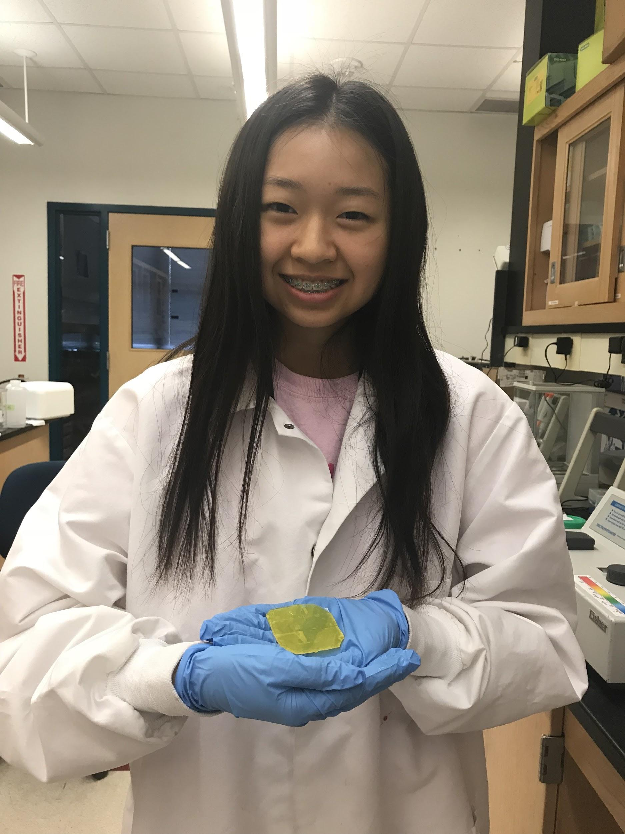
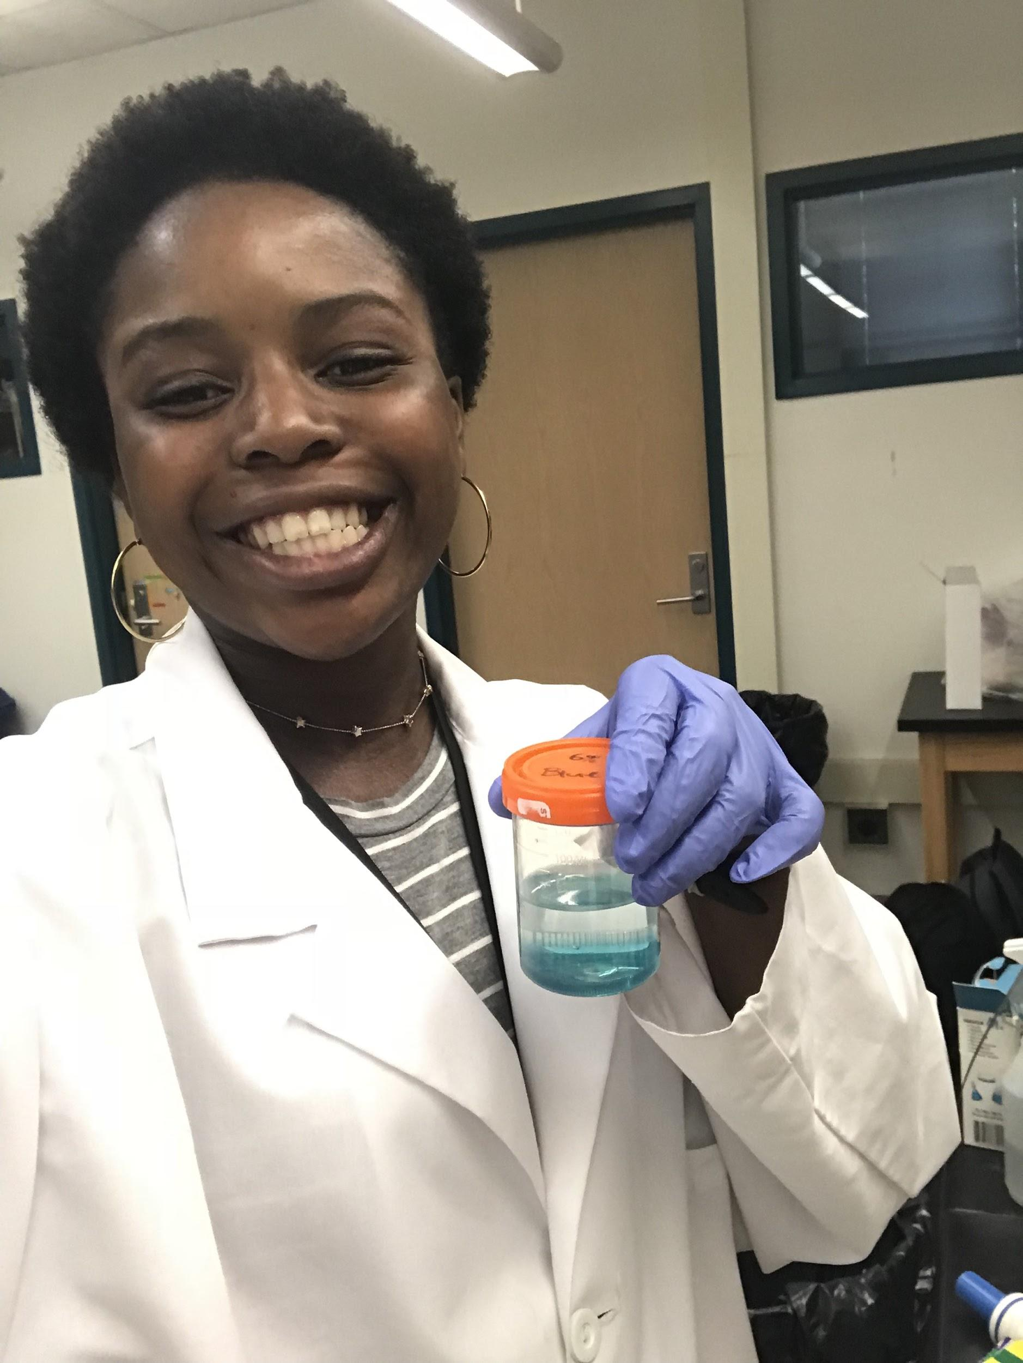
THE NEED
A way to prevent post-surgery patients from absorbing more than their prescribed dosage of opioid analgesics.
Users and Stakeholders
Patient Insurance Employer | Patient’s family and friends Doctors and Nurses Hospitals
Photos taken in the BioMedical Engineering Lab

Slide 4
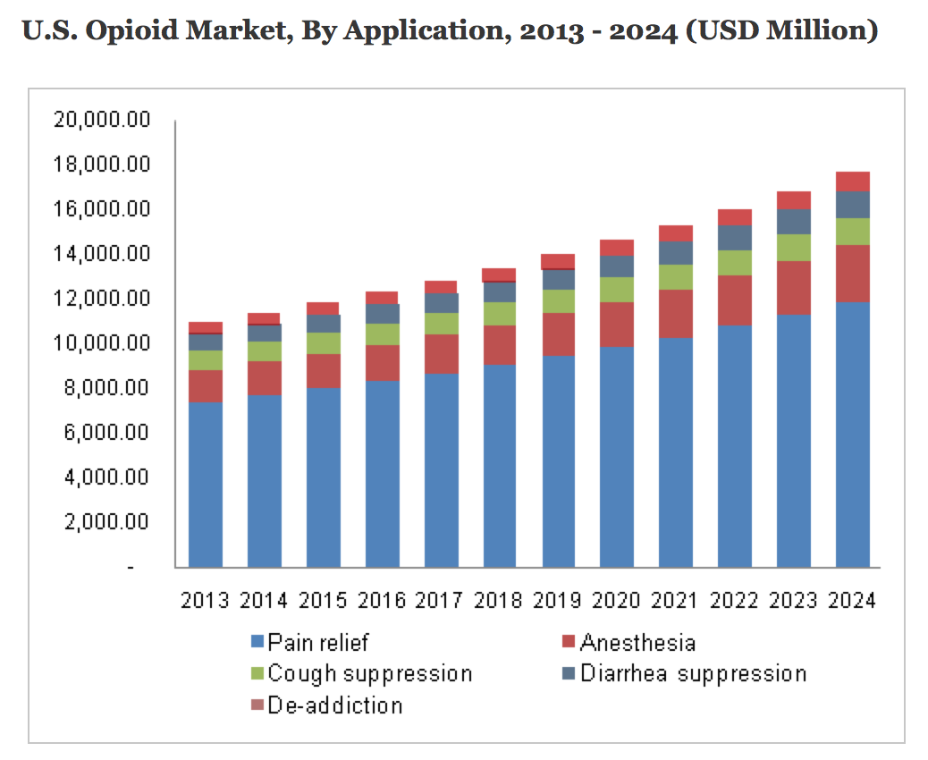
THE MARKET
Market Value
The North American Opioid Market is valued at $12.4 billion and is expected to grow by 4.6% per year*
*(Grand View Research, 2016)
Gap Analysis +
Competition
"North America Opioid Market Size Industry Report." Grand View Research, August 2016, GVR-1-68038-075-0
Gap
Outpatient Detox
Almost all the current treatments for opioid addiction such as detoxification centers focus on rehabilitation and are very expensive (up to $15,000), leaving a gap between performance and cost that we address with our product
Competition: Tactus Therapeutics’ tamper resistant opioid
Buprenor-phine
Performance
Tactus Therapeutics
Methadone Treatment
Cost

Slide 5
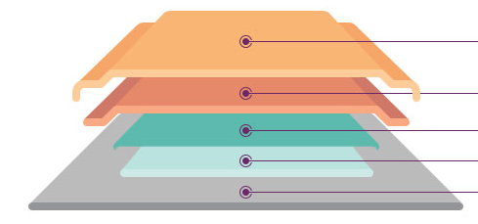

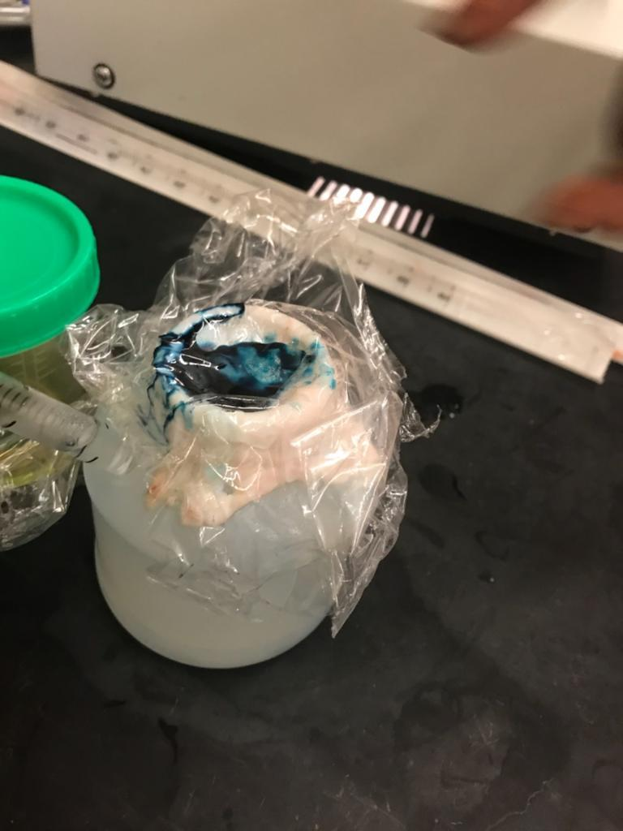
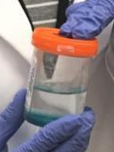
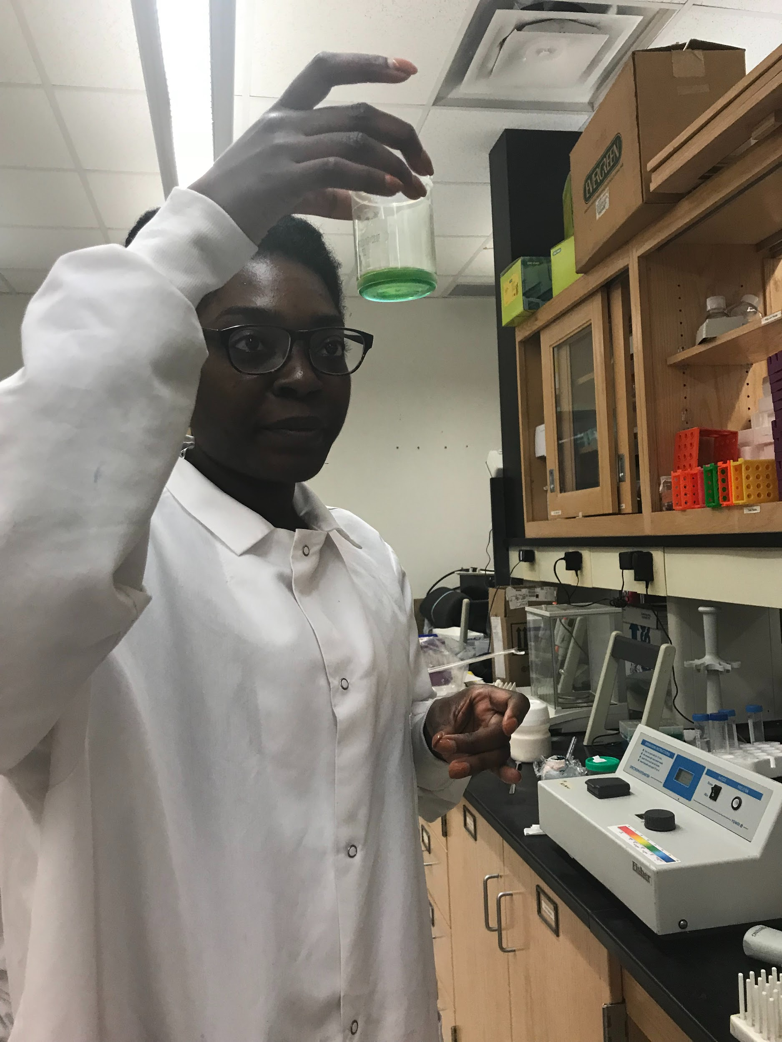
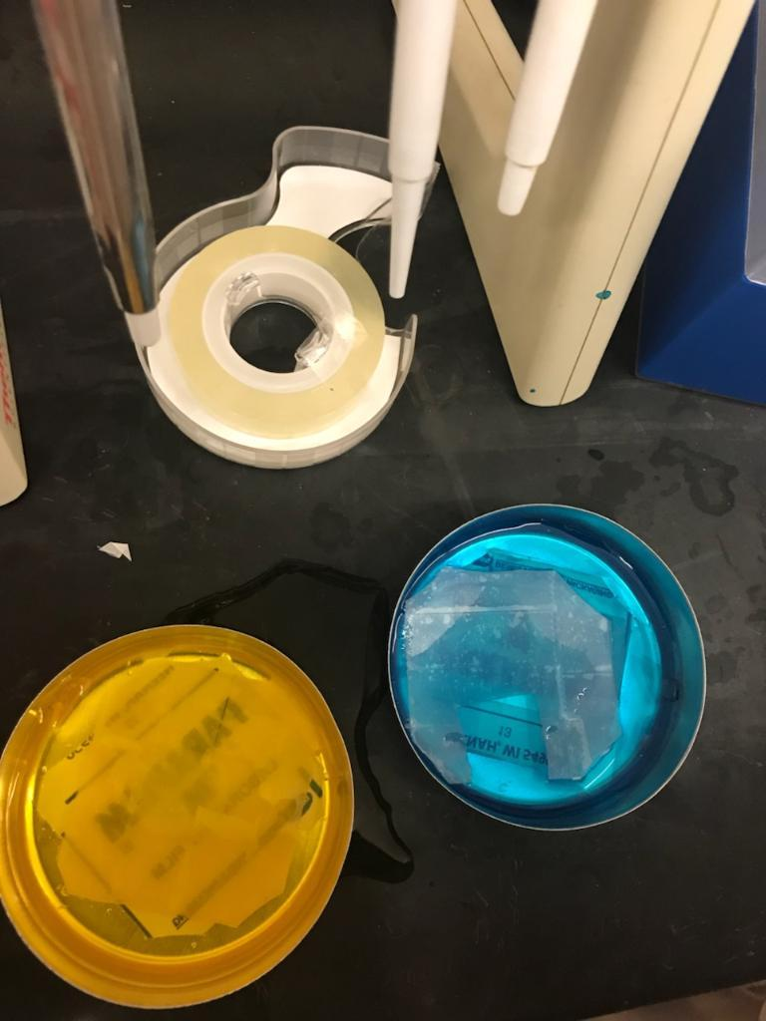
THE IDEAL PROTOTYPE
Our Solution
How Does it Work
Diffusion of opioid across membrane into skin
Opioid will diffuse out of the patch into the skin
Naloxone (Neutralizing Agent) will be diffusing into the skin at the same time but it will require a longer time to reach the surface
Backing
Naloxone
Membrane
Opioid
(Attached to skin)
Skin
“Cross section diagram of Butrans patch” Buprenorphine molecule + transdermal matrix technology: 7 days of continuous buprenorphine delivery, Butrans, https://butrans.com/delivery/transdermal-patch.html
Methods
Photos taken in the BioMedical Engineering Lab

Slide 6
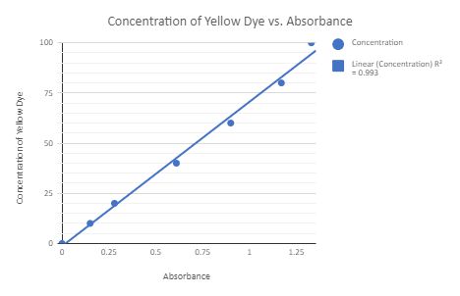

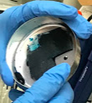
THE PROOF OF CONCEPT
Preliminary Data:
Methods
Chart created by MHM Novamen and Dr. Diane Nelson
Photos taken in the BioMedical Engineering Lab

Slide 7

Hazard Analysis
What could go wrong?
Transdermal patches have failed due to environmental factors
In 2006 PPSRS published a report detailing patients after entering MRI machines with their patches on *
Rates of absorption can vary depending on the the state of the patient **
Patients may not consider transdermal patches to be “real medicine” and therefore do not list it in questionnaires that say have you taken any drug?**
Unintentional over sedation **
*Pennsylvania Patient Safety Authority. “Foiled Again! Risk from Transdermal Patches in MRI Procedures | Advisory.” Pennsylvania Patient Safety Authority, patientsafety.pa.gov/ADVISORIES/Pages/200609_18.asp
*Weaver, Joel M. Advances in Pediatrics., U.S. National Library of Medicine, 2014, www.ncbi.nlm.nih.gov/pmc/articles/PMC3975607/
Image:Market, Vectors. “'Parking' by Vectors Market.” Iconfinder, www.iconfinder.com/icons/2502607/danger_hazard_sign_road_sign_safety_sign_warning_sign_icon.

Slide 8
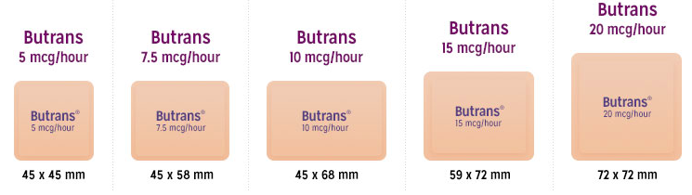
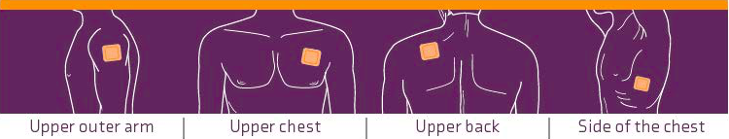
For the Future
Future Considerations
Physical Properties of the Transdermal Patch
Ensuring that diffusion is happening in one direction
Preventing the mix of Naloxone and the Opioid Drug
Creating different sizes and concentrations of the patch to provide for more patients
“Flexibility of 5 dosage strength, ” Patch Application, Titration, Mintanence, Butrans, https://butrans.com/delivery/transdermal-patch.html

